Slide 1
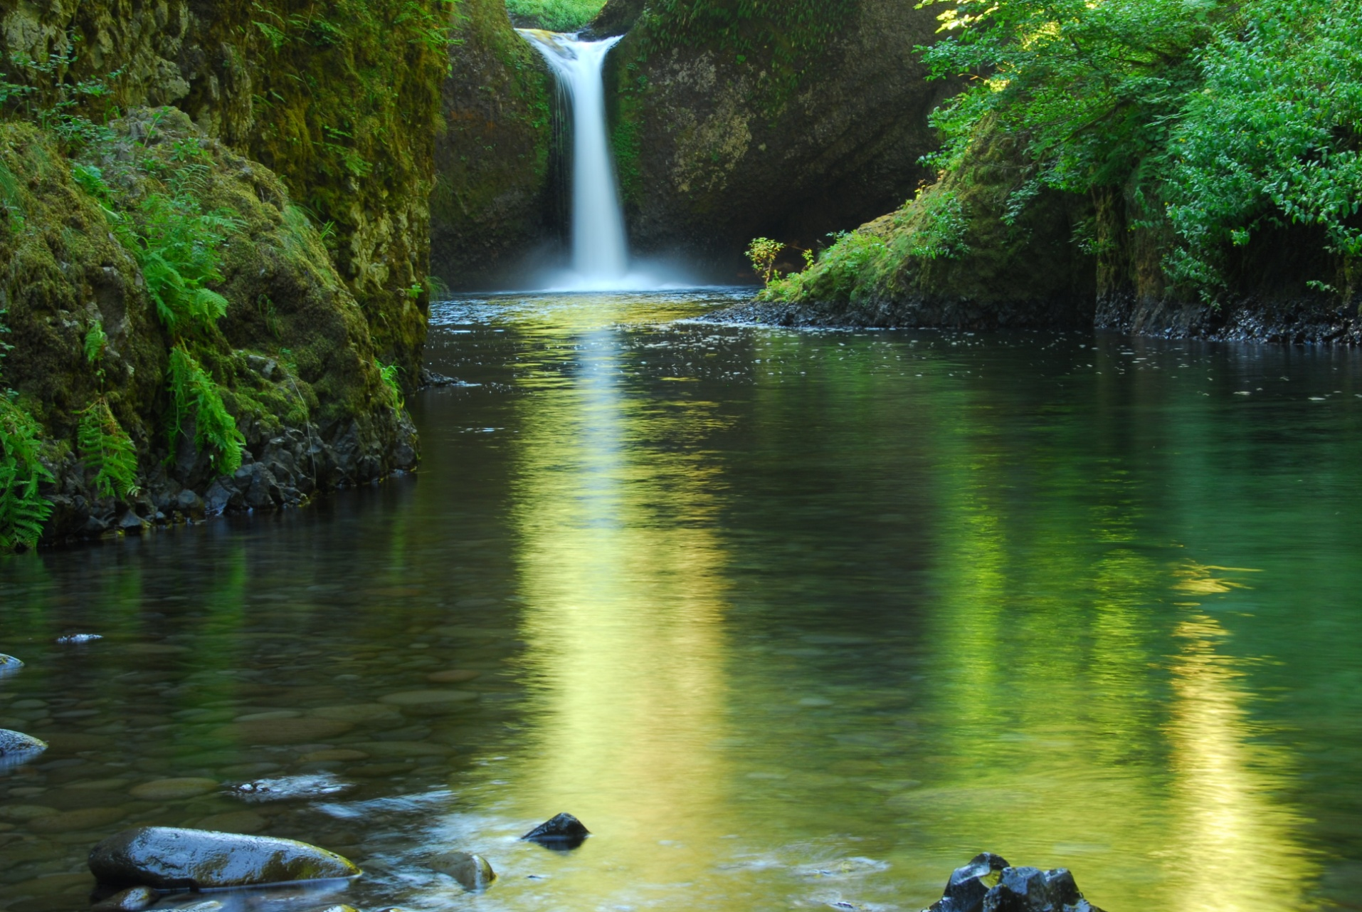

QGIS
A free powerful alternative to ArcMap
2017

Slide 2

QGIS
Quantum Geographical Information Systems (QGIS)
Can be used for any common GIS tasks
Reading shapefiles and rasters.
Reading csv tabular data.
Making maps.
Georeferencing images.
More complex GIS tasks
Interpolation.
Projecting data.
Geoprocessing.
Ex (Calculating the area of a shapefile)
Delivering Excellence with Every Solution
2

Slide 3
QGIS
Open Source vs closed source
Open source means that the software is not proprietary and anybody can use the software.
Examples of other open source projects include:
Python
Linux
Even Google assistant (Google home)
Examples of closed source projects include:
Anything developed by Microsoft (such as MS office)
ESRI products like ArcMap and Arcpy
Adobe pdf
Delivering Excellence with Every Solution
3

Slide 4
QGIS
Example
In this presentation, we will preform some simple routines a GIS analyst would often preform.
(In this case an informal survey of people’s favorite bars in Austin TX, we will make a map)
Create a csv file with coordinates
Add the csv to QGIS and view the data
Add a basemap, and label the points
Use the map layout tool
Add Scalebar and Legend
Export png or pdf
Delivering Excellence with Every Solution
4

Slide 5
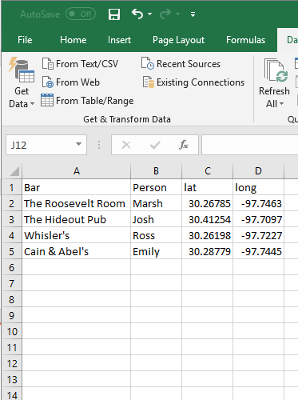
QGIS
Example
Csv with point data
Delivering Excellence with Every Solution
5

Slide 6
QGIS
Add csv or delaminated text files
Can be used for any common GIS task
Reading shapefiles and rasters.
Reading csv tabular data.
Making maps.
Georeferencing images.
More complex GIS tasks
Interpolation.
Projecting data.
Geoprocessing.
Ex (Calculating the area of a shapefile)
Delivering Excellence with Every Solution
6

Slide 7
QGIS
Add a Basemap
Can be used for any common GIS task
Reading shapefiles and rasters.
Reading csv tabular data.
Making maps.
Georeferencing images.
More complex GIS tasks
Interpolation.
Projecting data.
Geoprocessing.
Ex (Calculating the area of a shapefile)
Delivering Excellence with Every Solution
7

Slide 8
QGIS
Add Labels
Can be used for any common GIS task
Reading shapefiles and rasters.
Reading csv tabular data.
Making maps.
Georeferencing images.
More complex GIS tasks
Interpolation.
Projecting data.
Geoprocessing.
Ex (Calculating the area of a shapefile)
Delivering Excellence with Every Solution
8

Slide 9
QGIS
Add Scale Bar and Legend
Can be used for any common GIS task
Reading shapefiles and rasters.
Reading csv tabular data.
Making maps.
Georeferencing images.
More complex GIS tasks
Interpolation.
Projecting data.
Geoprocessing.
Ex (Calculating the area of a shapefile)
Delivering Excellence with Every Solution
9

Slide 10
QGIS
Adjust Legend
Can be used for any common GIS task
Reading shapefiles and rasters.
Reading csv tabular data.
Making maps.
Georeferencing images.
More complex GIS tasks
Interpolation.
Projecting data.
Geoprocessing.
Ex (Calculating the area of a shapefile)
Delivering Excellence with Every Solution
10

Slide 11
QGIS
From here we can export to a pdf or png
Can be used for any common GIS task
Reading shapefiles and rasters.
Reading csv tabular data.
Making maps.
Georeferencing images.
More complex GIS tasks
Interpolation.
Projecting data.
Geoprocessing.
Ex (Calculating the area of a shapefile)
Delivering Excellence with Every Solution
11

Slide 12
QGIS
Map Layout
In the Map Layout feature you can:
Add legend(s)
Add scalebar
Add title and text
Export map to image or pdf
Delivering Excellence with Every Solution
12

